Slide 1
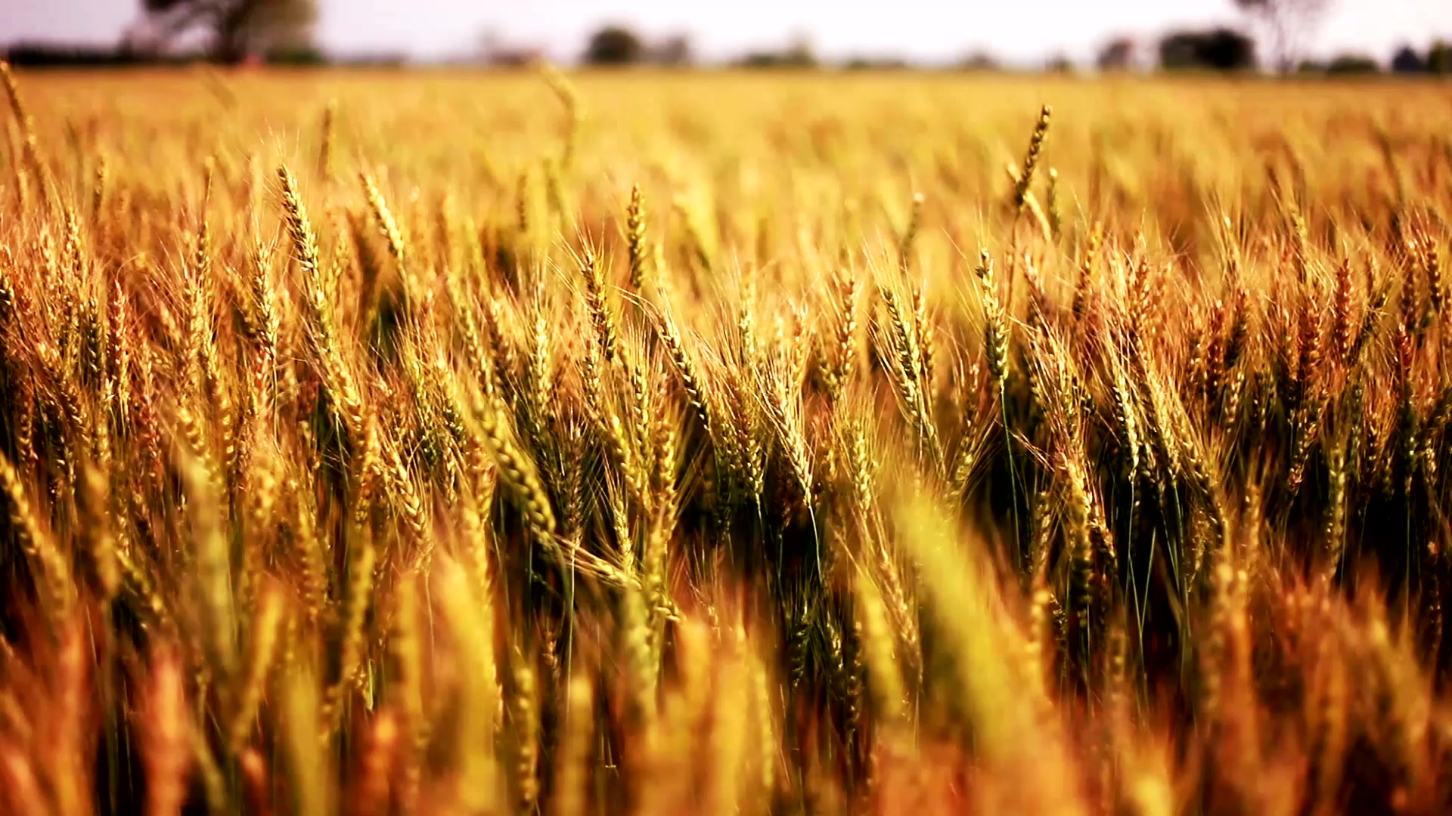
CROP YIELD
Indian Agricultural Productivity Analysis
Presented by :- Sanskar Sahu

Slide 2
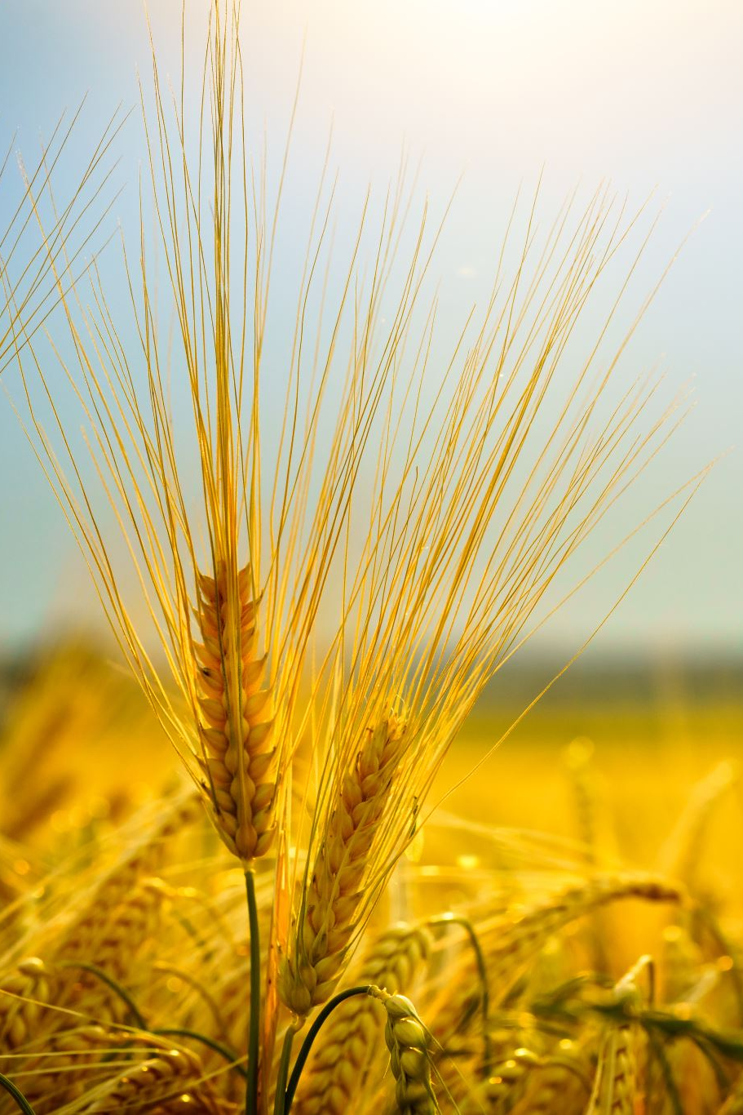
INTRODUCTION
Introduction to the significance of predicting crop yield for sustainable agriculture.
Explanation of how data science is revolutionizing agricultural practices.
Key Points:
Understanding the importance of crop yield prediction.
Harnessing data science techniques for better agricultural outcomes.

Slide 3
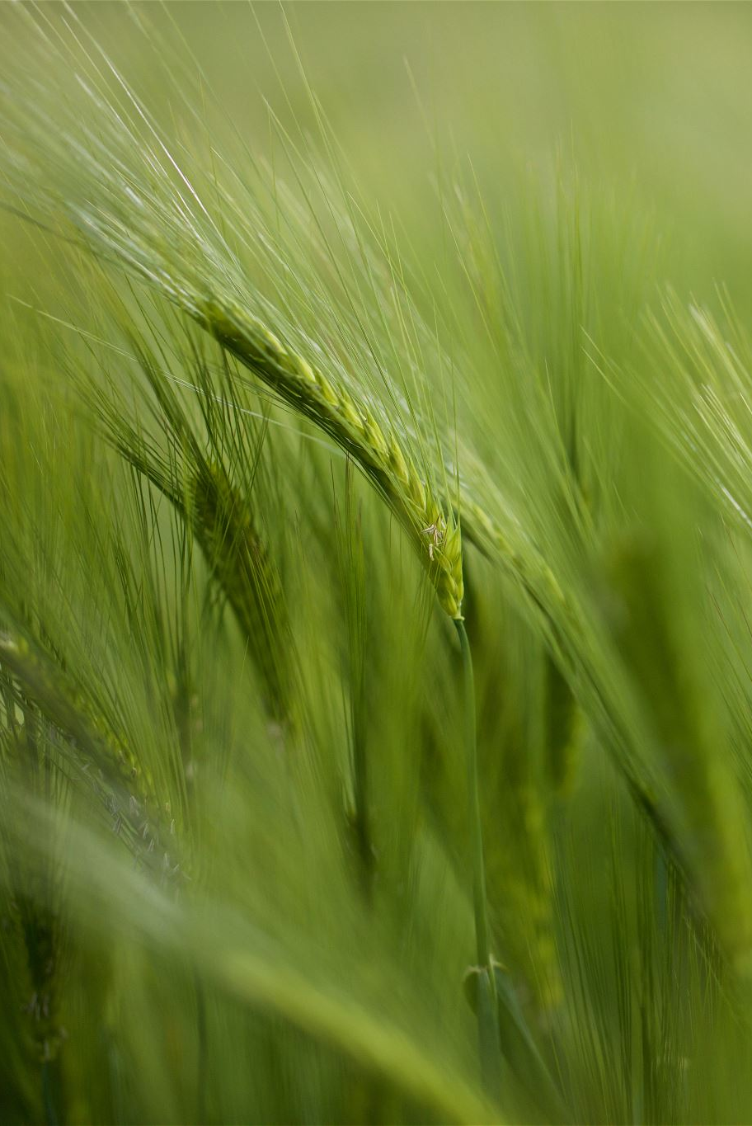
OBJECTIVE
Create computer programs that use data to guess how many crops will grow and find out what helps farmers grow more food. This helps make sure we can always have enough food to eat and keep our planet healthy.

Slide 4
DATA PROCESSE-FLOW
DATA DECRIPTIVE
EXPLORATORY DATA ANALYSIS
MODEL BUILDING
MODEL SELECTION
CONCLUSION

Slide 5
TOOLS AND PLATFORM USED
TOOLS:- Python
PLATFORM:- Jupyter Notebook
Library Used :- Numpy, Pandas, Matplotlib, Seaborn, Sk-learn

Slide 6
DATA DESCRIPTION
Crop: The name of the crop cultivated.
Crop_Year: The year in which the crop was grown.
Season: The specific cropping season (e.g., Kharif, Rabi, Whole Year).
State: The Indian state where the crop was cultivated.
Area: The total land area (in hectares) under cultivation for the specific crop.
Production: The quantity of crop production (in metric tons).
Annual_Rainfall: The annual rainfall received in the crop-growing region (in mm).
Fertilizer: The total amount of fertilizer used for the crop (in kilograms).
Pesticide: The total amount of pesticide used for the crop (in kilograms).
Yield: The calculated crop yield (production per unit area).

Slide 7
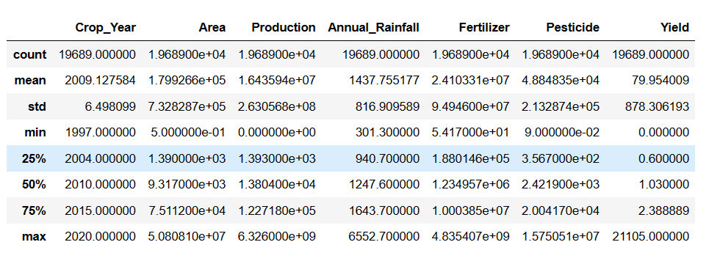
EXPLORATORY DATA ANALYSIS(EDA)
WE CAN SEE THAT MOST OF THE VALUE IS NUMERICAL.
WE CAN SEE OUTLIER FACTOR.
EVEN ZERO ALSO PRESENT.

Slide 8
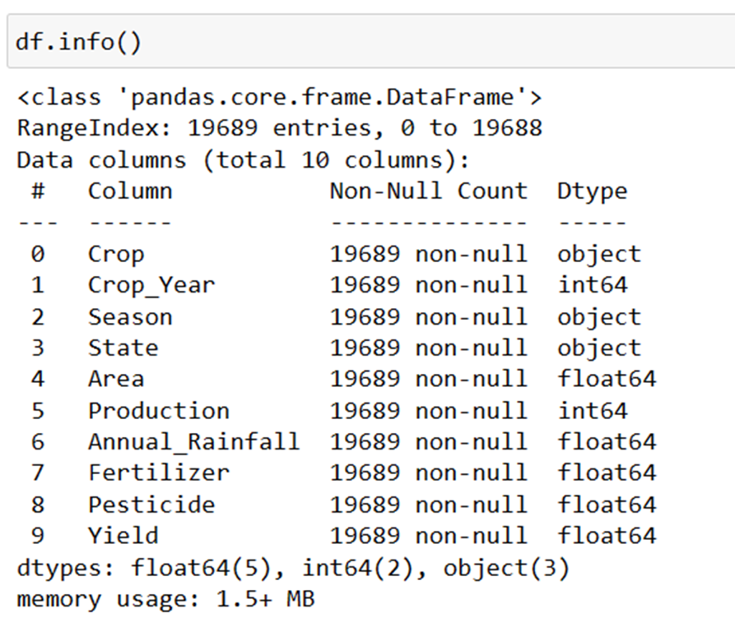
DATA INFORMATION
THERE IS NO NULL VALUE IN THIS DATA SET.
THERE ARE 10 COLUMNS & 19690 ROWS IN THIS DATASET.
THREE CATEGORICAL COLUMNS.

Slide 9
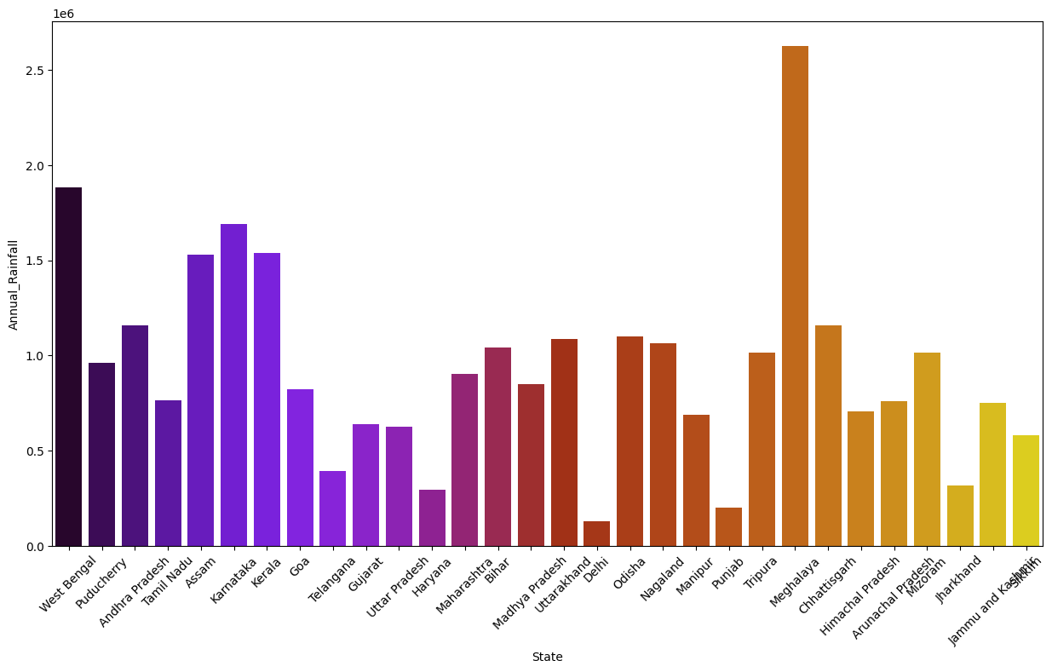
ANNUAL RAINFALL HIGHEST ONE IS MEGHALAYA AND SECOND ONE IS WEST BENGAL

Slide 10
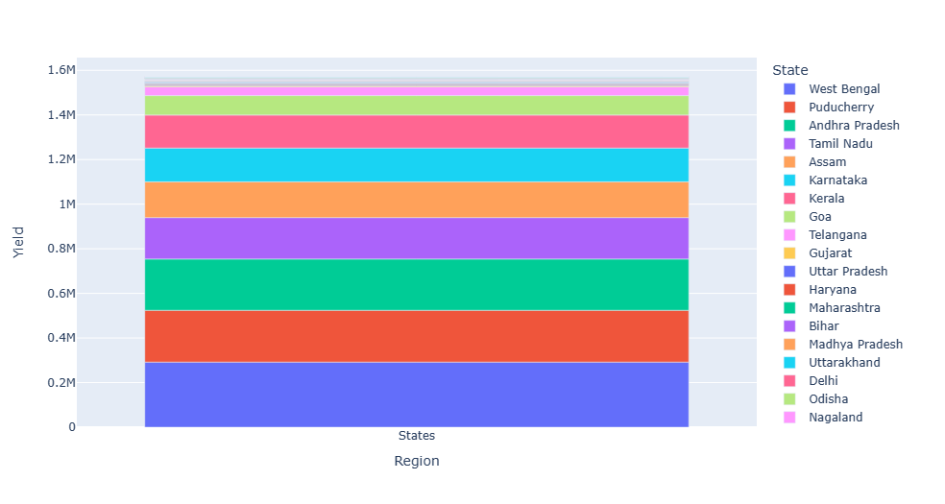
BAR PLOT OF YIELD AND REGION From the below graph, it can be observed that the yield of West Bengal is the highest. Reason can be more annual rainfall, use of fertilizers.

Slide 11
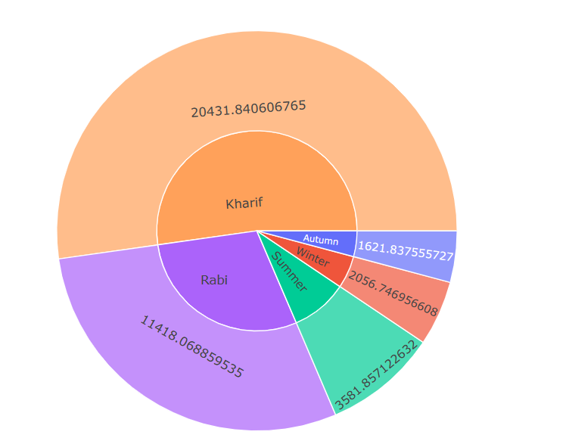
BAR GRAPH OF SEASON
The area under cultivation in the Kharif season is highest, second is the Rabi season.
Yield in India is maximum in Kharif season
Crops in autumn, and summer are not grown over large area.

Slide 12
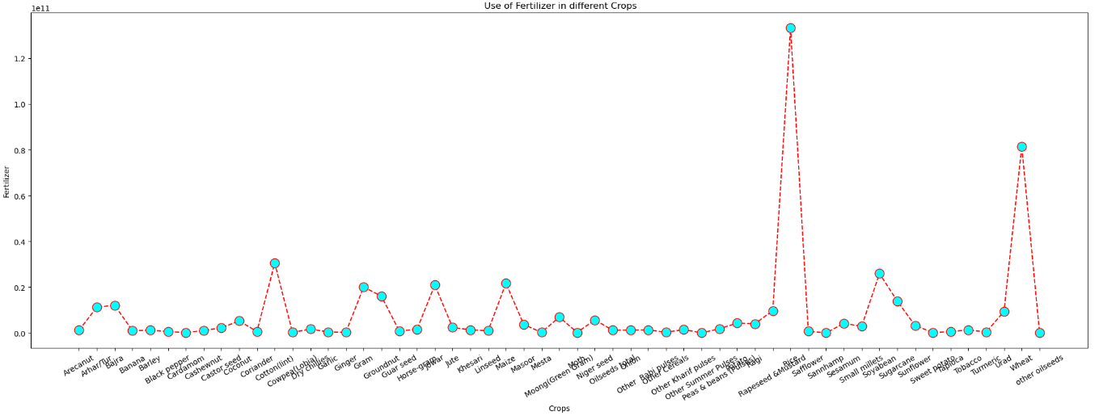
USE OF FERTILIZER IN DIFFERENT CROPS THE MOST AMOUNT OF FERTILIZER IS USED IN RICE CROPS. THE SECOND CROP TO USE MORE FERTILIZER IS WHEAT CROP.

Slide 13
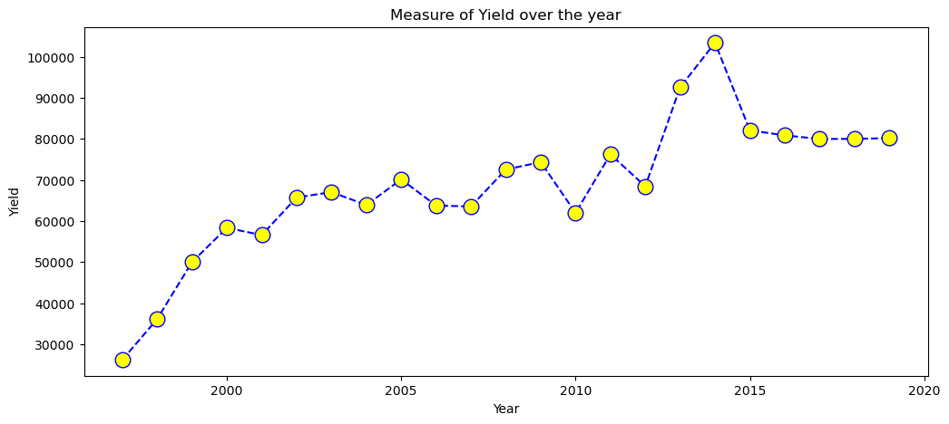
MEASURE OF YIELD OVER THE YEAR It can be observed that the yield has increased over the year, but after 2014 it is showing a declining trend. Reasons can be climate change, decrease in soil fertility

Slide 14

MODEL BUILDING
LINEAR REGRESSION
RANDOM FOREST REGRESSOR

Slide 15

LINEAR REGRESSION
TRAIN ACCURACY:- 85%
TEST ACCURACY:- 81%
THIS IS A GOOD FIT MODEL

Slide 16

RANDOM FOREST
TRAIN ACCURACY:- 81%
TEST ACCURACY:- 76%
THIS IS A GOOD FIT MODEL

Slide 17

MODEL PERFORMANCE
Based on the provided training and test accuracies, Linear Regression outperforms Random Forest in terms of both training (0.85) and test (0.81) accuracy, suggesting that Linear Regression is the better model choice for this specific dataset.

Slide 18

CONCLUSION
After comparing two ways of guessing how many crops will grow, we found that one way, called Linear Regression, was better than the other way. Linear Regression was like guessing with 85% accuracy on training data and 81% on testing data. This means Linear Regression is a good choice for guessing crop yields. Our goal is to use these methods to help farmers grow more food and keep everyone fed.

Slide 19
THANK YOU…….

